Slide 1
Station Experience Design Guidelines
SDC Briefing
11/2/2023

Slide 2
Outline
Introductions
ST Design Standards
Station Experience Design Guidelines (SEDG)
Passenger Experience Expectations
Station Design Guidelines
Station Environment
Additional Topics
Passenger Restrooms
Retail
Vertical Circulation
Number of Entries

Slide 3
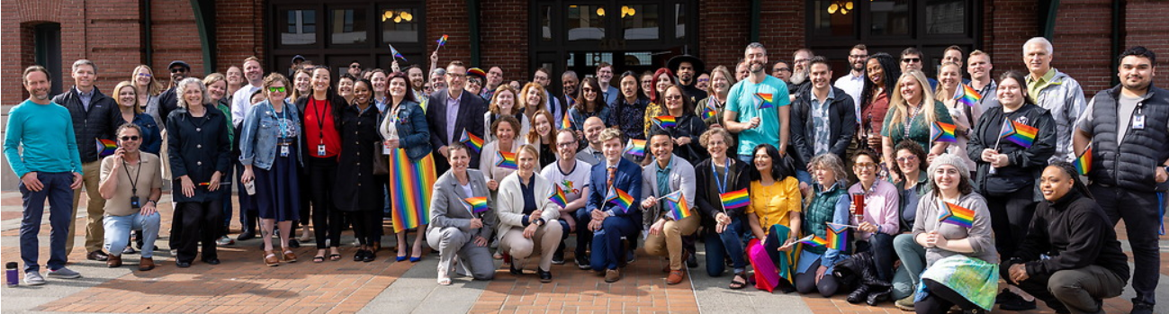
Introductions
Julie Montgomery, Director of Architecture and Art
Soraya Lowry, High Capacity Development Manager
Kate Lichtenstein, Light Rail Development Manager

Slide 4
Sound Transit Mission and Priorities
Mission:
Connecting more people to more places to make life better for our communities and create equitable opportunities for all.
Strategic priorities:
Great Ride - Deliver a safe, welcoming, and equitable passenger experience.
One ST - Transform our culture to enable unity and focus.
An ST Goal: 100% application of SEDG on ST3 projects

Slide 5
Sound Transit Organization
Partial Agency Organization Chart
Separate Departments for project delivery and standards provides internal checks and balances
Passenger Experience and Operations as customer
CEO
Chief Expansion Delivery Officer
Chief System Quality Officer
Portfolio Services Office
Planning Environment, and Project Development
Design, Engineering, and Construction Management
Engineering/ Standards
Chief Service Delivery Officer
Passenger Experience
Operations

Slide 6
Sound Transit Design Standards
Standards Documents Include
ST Requirements Manual (previously Design Criteria Manual)
Standard and Directive Drawings
Standard Specifications
Signage, Utility and other manuals
Station Experience Design Guidelines
Online at https://www.soundtransit.org/get-to-know-us/doing-business-with-us/design-standards

Slide 7
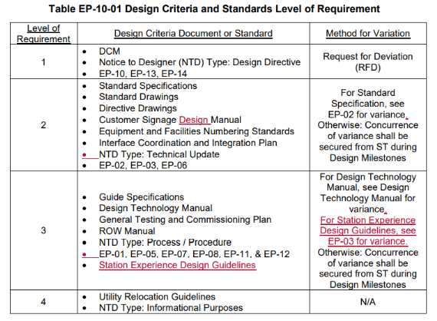
Sound Transit Design Standards
Engineering Procedures 10 (EP-10)
Sets order of precedence
Establishes procedures for compliance/non-compliance

Slide 8
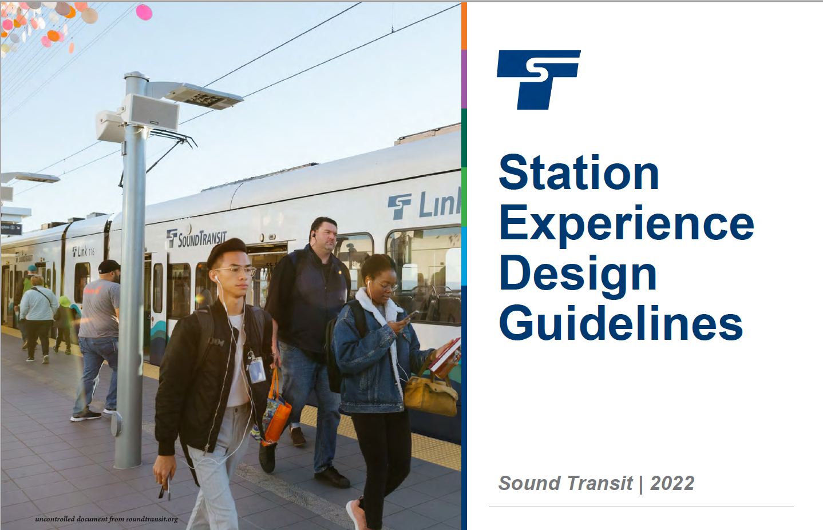
Why have Station Experience Guidelines?
ST Value of Passenger Focus:
We always start with our passengers’ needs and work back from there. They are the focus of everything we do.
What is the SEDG?
An illustrated primer of Link design from the passenger perspective
Required on ST3 projects in tri-county area

Slide 9
Three Key Focus Areas
Passenger Experience: Define the passenger experience: passenger attributes, pedestrian flow, access, transit mode integration, etc.
Link Station Design: Set expectations for Link station design and standardization in support of the passenger experience
Station Environment: Provide guidelines for station access, urban design, and TOD implementation for a station area that supports passengers
Notes:
Additional info:
Leveraging practices and lessons learned from projects to date
Visual tool to define expectations for Link
Refers to other technical documents for details
Clear description of standardized passenger experience
Identifies opportunities for placemaking with color, art and some materials
Documents requirements for wayfinding, fare paid zone, advertising locations, and retail
Identifies strategies for facilitating maintenance for desired PX
Describes principles to assist in working with partners

Slide 10
Cost Considerations & Lessons Learned
Controlling costs through:
Standardized passenger experience
Clear expectations in design for passengers
Realms of responsibility and guidance for station areas
Investment framework for station access
Lessons Learned:
Lessons learned from previous ST work combined with best practices gathered from peer agencies are incorporated into the SEDG

Slide 11
Passenger Experience Design Principles

Slide 12
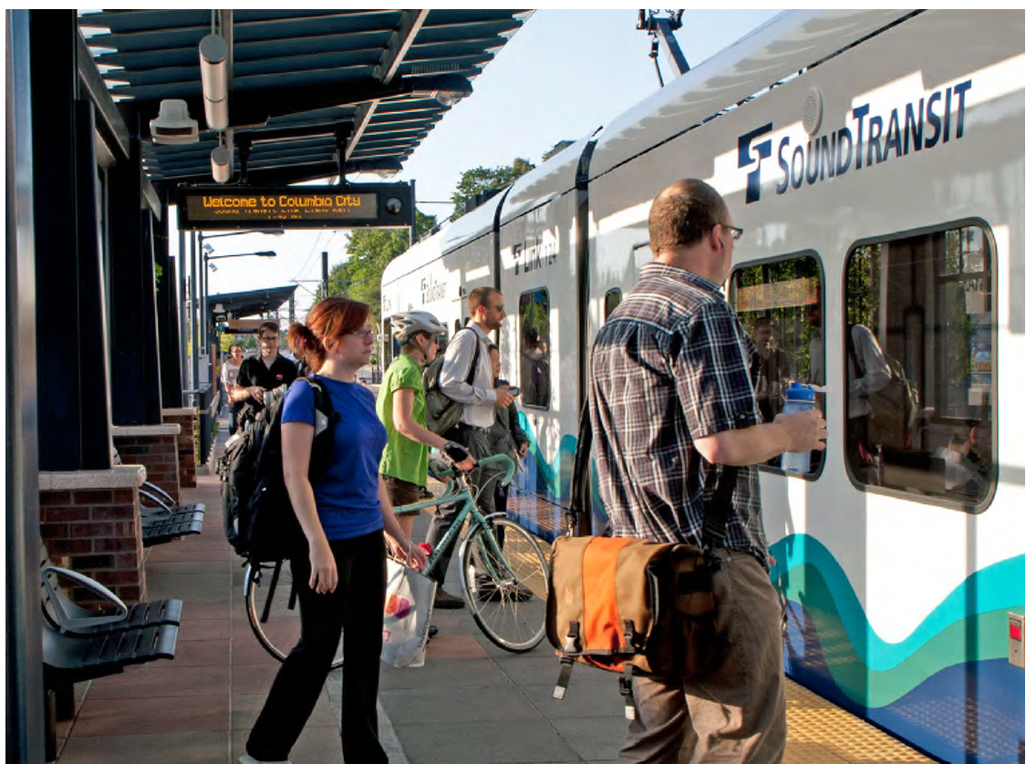
Passenger Experience defined
Measurable Passenger Experience Aspects
Dependable, Safe, Available, Clean and Informed
Principles of Passenger Experience
Simple, Seamless, Intuitive and Resilient
Notes:
Defining the passenger experience
Measurable items
Principles: Simple, seamless, intuitive

Slide 13
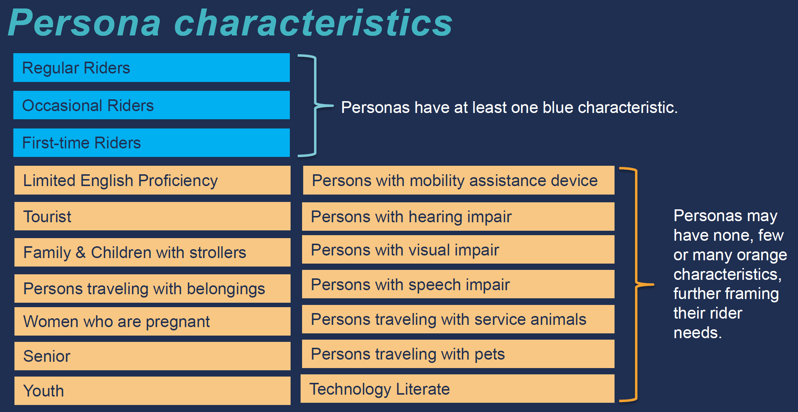
Passenger Characteristics
Designing for Passenger Needs
Notes:
a break down of characteristics of our passengers, which is based on research paper like from APTA and also based on observing the passengers in the Puget Sound area. We included characteristics of each of the persona group in the Station Experience Design Manual.

Slide 14
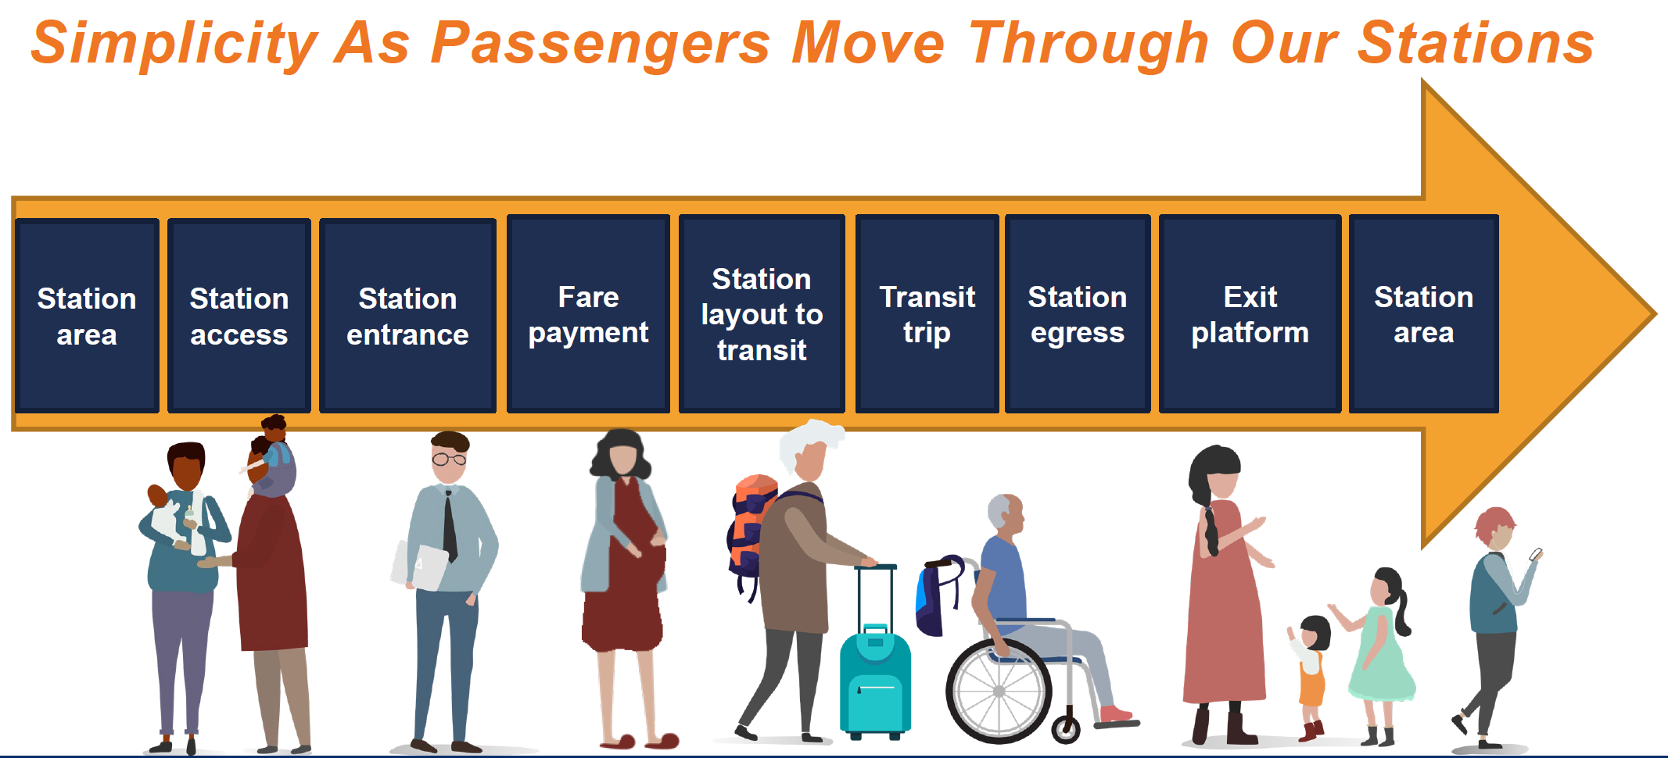
Passenger journey sequence on Link
Notes:
A passenger journey’s has an origin and destination. And if they are choosing to journey on Link light rail, they will be interacting with our system starting from when they enter the station of their origin, and ending when they exit the station of their destination. Though the journey on Link light rail system, we want to provide the experience of simple by provide a consistence sequence when they journey on Link, no matter if the station is at-grade, elevated or underground.

Slide 15
Link Station Design Principles

Slide 16
Station Standardization
Consistency in
Ticketing areas
All elements of vertical circulation (public stairs, escalator finishes and enclosure, elevator shaft, elevator cab finishes)
Canopy design
Lighting type and location
Ancillary spaces
Creating Efficiency in
Passenger Flow, Design, Construction, Maintenance and Operations
Notes:
In order to support the passenger experience in being simple, seamless and intuitive, we will be moving from “customized stations with standardized elements” to “standardized stations with customized elements”
We need consistency in things like ticketing areas, vertical circulation, canopy design, etc for consistency in the passenger flow, design, construction and maintenance of our stations. Even details like bike runnels must be appropriately standardized since it’s often the details that passengers directly experience which make the a station working well.

Slide 17
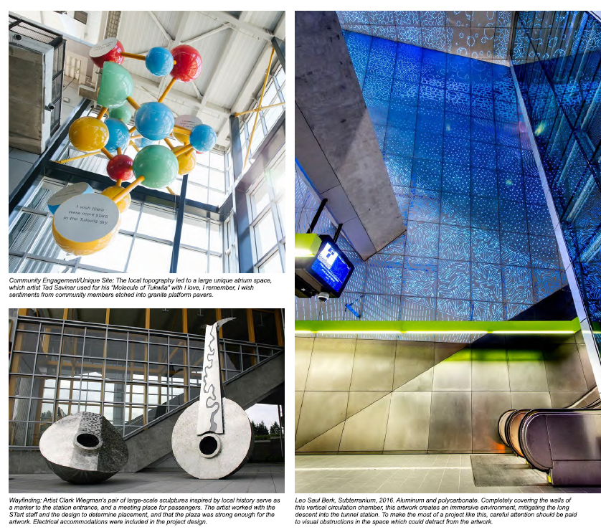
Neighborhood Identity
Customized Elements:
Public Art integrated with architecture
Selection of wall and floor finishes in durable, maintainable materials
Accent color
Plaza design elements
Landscape plantings

Slide 18
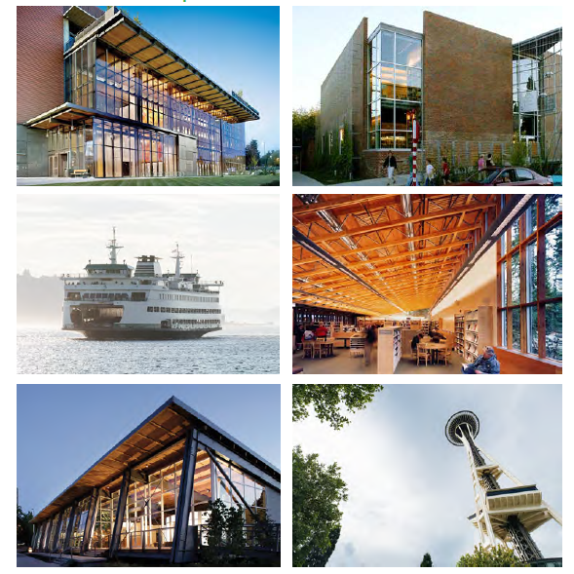
Design Concept
ST design style:
Reflect PNW history including indigenous culture
Modern
Simple, elegant, straight-forward

Slide 19
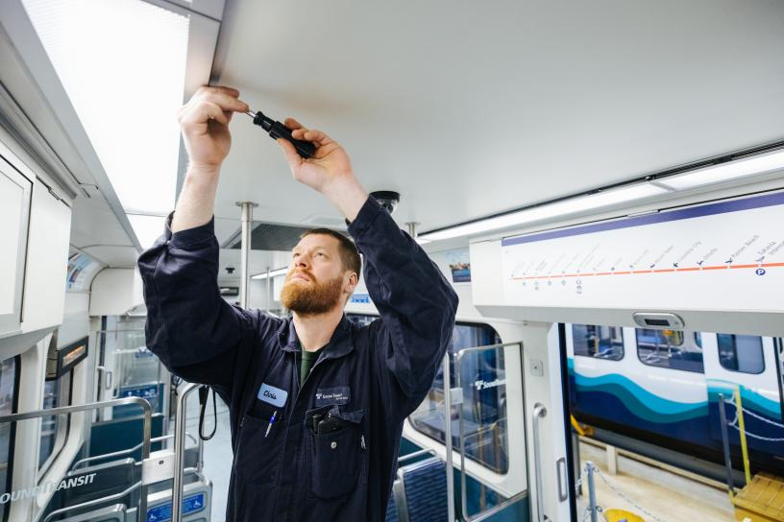
Maintenance Requirements
Fundamental to Passenger Experience
Clean, well-functioning
Height of equipment access
Hierarchy of maintenance access
Limit the height of canopies and ceilings

Slide 20
Station Environment Framework

Slide 21
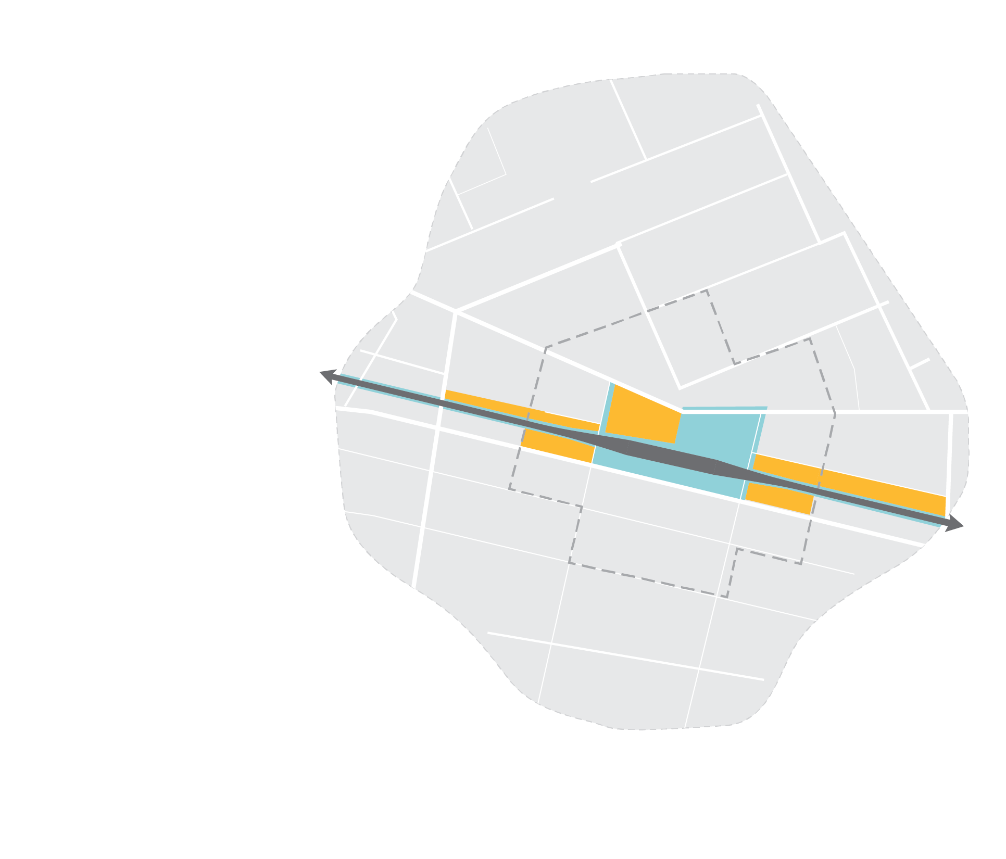
Station Environment
Consists of
Station
Station Context
Station Area
Access routes/modes
Station context (ST and City)
Station access (ST and City)
Operations Footprint (ST)
Construction Footprint (ST)
Station facilities (ST)
Station area (City/AHJ)

Slide 22
Station Environment Typologies
Station Land Use Types
Characterizes Station Areas by the current and future urban form and land use patterns in the surrounding area for co-planning
Established Urban
Emergent Urban
Single Use
Notes:
Why Typologies?
To characterize or “diagnose” station areas according to land use conditions and desired modal mix along an HCT corridor
To guide urban design strategies and long-term change in the station area
To envision the future form of ST investments in support of a good passenger experience
Station Land Use Types - These types depict existing and future development,
uses and activity around the station, which ultimately affect the passenger’s interaction with the station and the station’s role in the community.

Slide 23
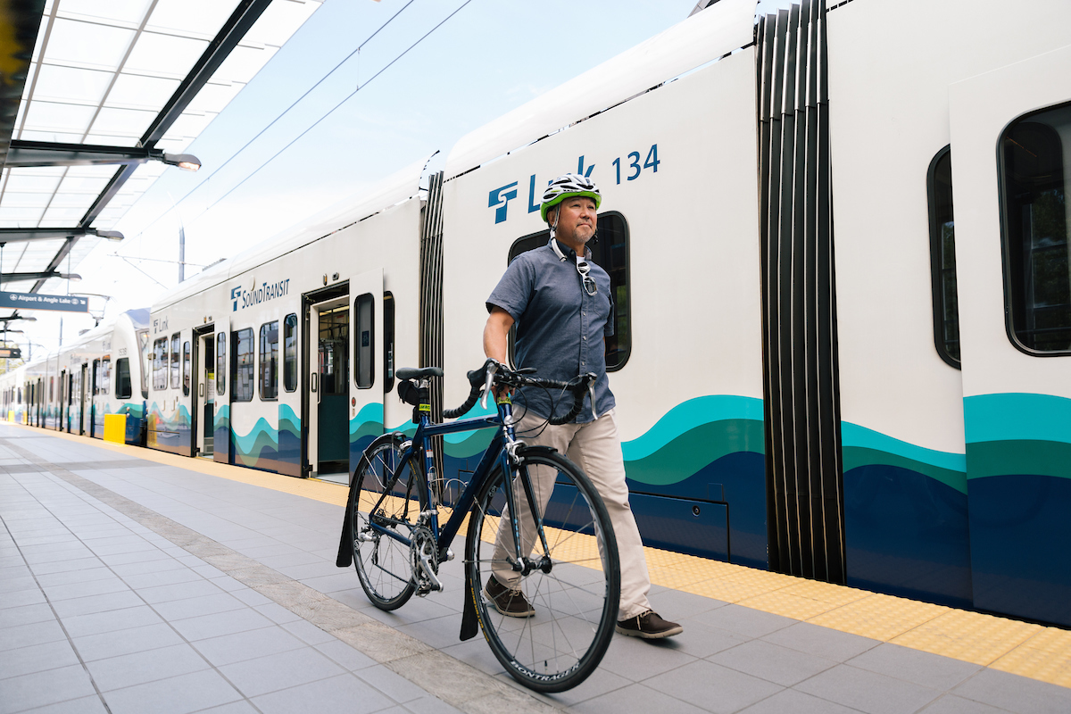
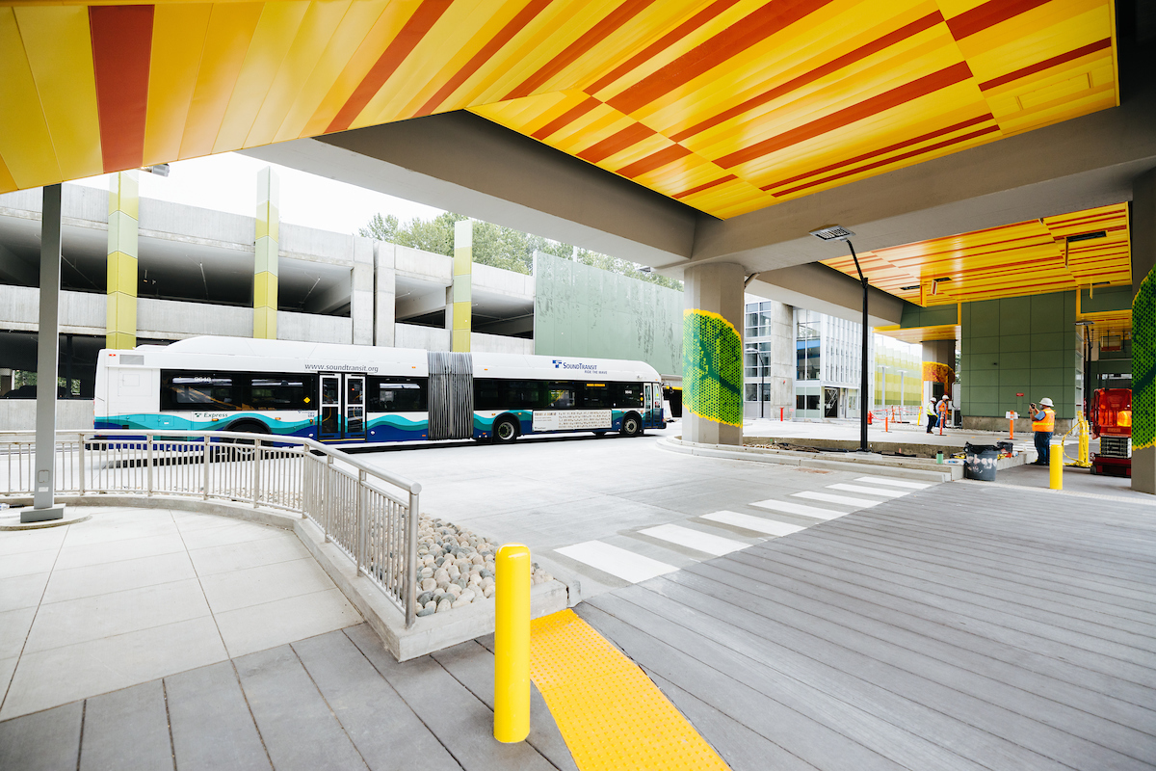
Station Environment Typologies
Station Access Types*
Characterizes Station Environments by the current and future access mode share and other access characteristics
Related to co-planning
Walk/Bike/Roll
Multimodal
Auto
* References the System Access Implementation Plan
Notes:
Station Access - Sound Transit uses a station access typology to describe existing and new stations based on access mode share and other access characteristics, including supportive transportation networks and station land use context.
Station access types are determined by the mode split. It should also be noted that we can have a current/future view of these types depending on the co-planning effort with the AHJs and, again, what their vision is for the station area. The access "characteristics" or options can shift, but this takes partnership and investments from AHJs as well as progressive visions around future mode splits.

Slide 24
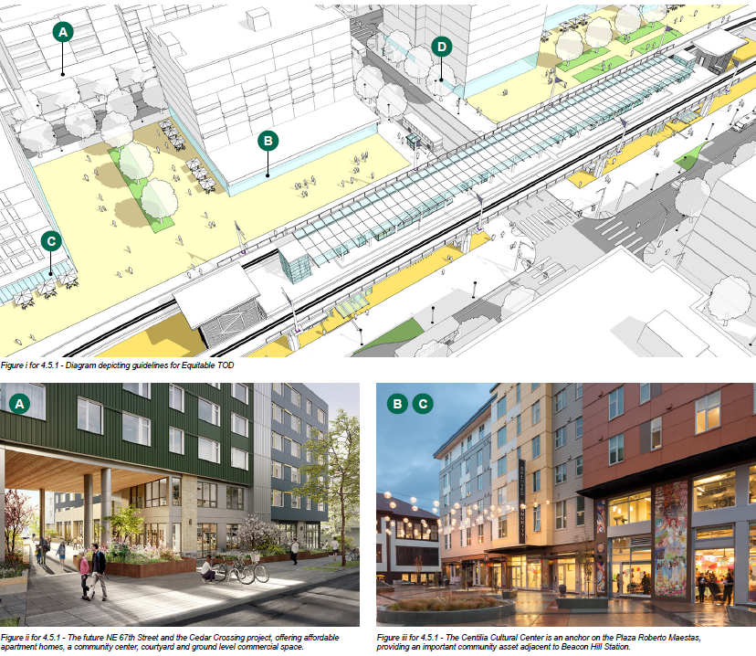
Support Equitable TOD in Link Station Areas
Plan for and support equitable, affordable housing development in agency TOD
Support opportunities for community services, retail, small businesses and living wage employment
Right size parking requirements for developments in station areas
Notes:
Support integration of community services
Support opportunities for retail Support small businesses and living wage employment opportunities
Right size parking requirements for developments in station areas

Slide 25
Additional Topics

Slide 26
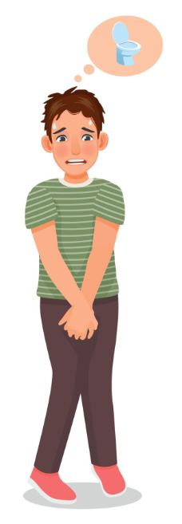
Passenger Restrooms
Challenges
Cleanliness
Maintenance and repair
Illegal use
Opportunities
Passenger comfort
Supports passengers on their journey
Placement
Follow Washington State building code amendments

Slide 27
Passenger Restrooms
ST Standards from ST Requirements Manual
822.3.22.3.1 Public restrooms must be provided at stations when all the following criteria are met:
i. A station averages 10,000 or more boardings per day.
ii. A station where the nearest public restroom is farther than a 20-minutes ride.
iii. Five or more transit routes converge at a location
Unisex
Remote security access
Durable fixtures and finishes
Within Fare Paid Zone

Slide 28
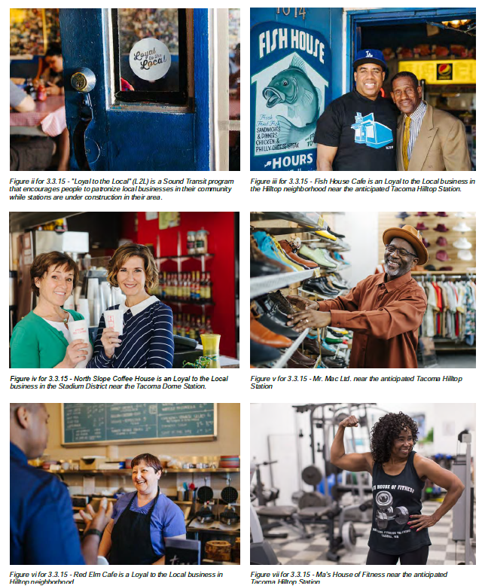
Retail
In Station Area
Adjacent to station in surrounding buildings
On ST property
Retail spaces only if market study indicates need and internal management provided
Vending machines may be used
Vending cart (i.e. coffee cart)

Slide 29
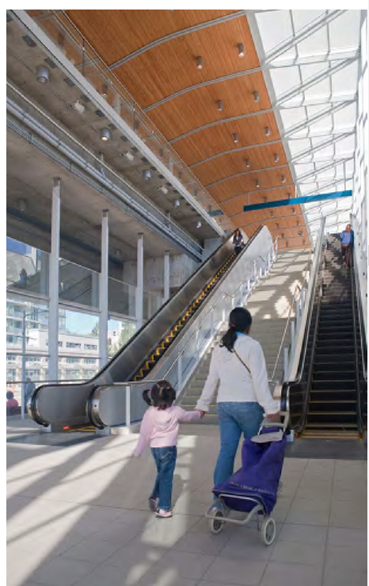
Vertical Conveyances
Maintenance program
Update on current practice and performance
Lessons learned
Always have stairs next to or near escalators
Heavy duty transit grade units
Passenger flow modeling

Slide 30
Number of Station Entries - Background
Preference is for one station entry where possible
One station entry provides:
Some conditions may indicate the need for a second entrance
Emergency exits will be provided per code
Simplicity of wayfinding
Streamlined maintenance and security needs
Lower capital and operating costs
Two elevators in close proximity

Slide 31
Number of Entries
A second entry may be provided if
If one entrance cannot provide adequate entry and exit width
If the Right of Way adjacent to a single station entrance is not wide enough to accommodate the flow of pedestrian traffic
At stations near event venues with major events
If transit partner operations require greater than 50% of passengers transferring between modes to cross an arterial projected to have >8,500 average daily traffic volume
Additional entrances may be provided through connections to buildings and private property.in joint development

Slide 32
In summary
The Station Experience Design Guidelines
Provides the framework for supporting passengers through Link station design and planning of the station area
Required on ST3 projects including West Seattle and Ballard, Tacoma Dome and Everett Link Extensions

Slide 33
Thank you

