Slide 1


Transportation Planning Overview
Levy Oversight Committee
Tracy Krawczyk
August 25, 2016

Slide 2
Our mission, vision, and core values
Mission: deliver a high-quality
transportation system for Seattle
Vision: connected people, places, and products
Committed to 5 core values to create a city that is:
  Safe
  Interconnected
  Affordable
  Vibrant
  Innovative
For all
Notes:
FMP speaks directly to our core values. It strives to provide safe and interconnected movement of goods in support of a vibrant economy

Slide 3
Policy & Planning division role
Develop policies to guide mobility, access and placemaking uses with city street rights of way
Deliver plans to make it easier to walk, bike, take transit and move goods
Transform streets into inviting public places
Inform local and regional transportation investments decisions

Slide 4
2016 work plan highlights
Planning
Comprehensive Plan update ROW allocation policies Level-of-service policies Pedestrian Master Plan Update Freight Master Plan Transit Master Plan update One Center City Move Ballard Judkins Park light rail access Duwamish River Valley IDT
Revenue & Capital Development
Capital project prioritization Regional planning Grant applications Federal legislation review/ comment
Urban Design
Complete Streets Program Streetscape concept plans Tactical urbanism Pavement to Parks Program Right-of-Way Improvements Manual Update

Slide 5
From plan to implementation
Comprehensive Plan
land use and transportation vision
to support growth
Modal, Subarea & Operational Plans
articulate solutions and priorities
Move Seattle
10-year Strategic Vision
Capital Investment Program(CIP)
6-year funding priorities
Project/Program Implementation

Slide 6
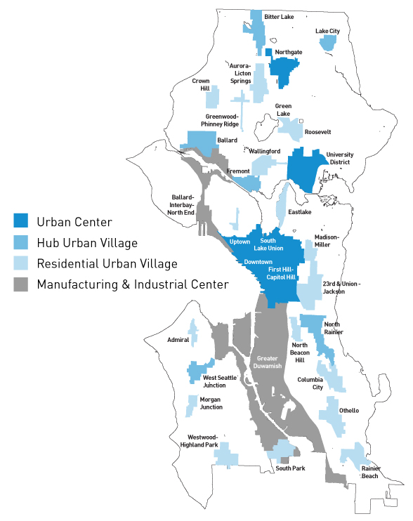
Comp Plan growth strategy
Focus growth to more efficiently serve it
  Urban centers
  Manufacturing & industrial centers
  Urban villages
80% of city growth in centers/villages since 1994
Future growth targets 2015-2035
  70,000 additional households
  115,000 additional jobs

Slide 7
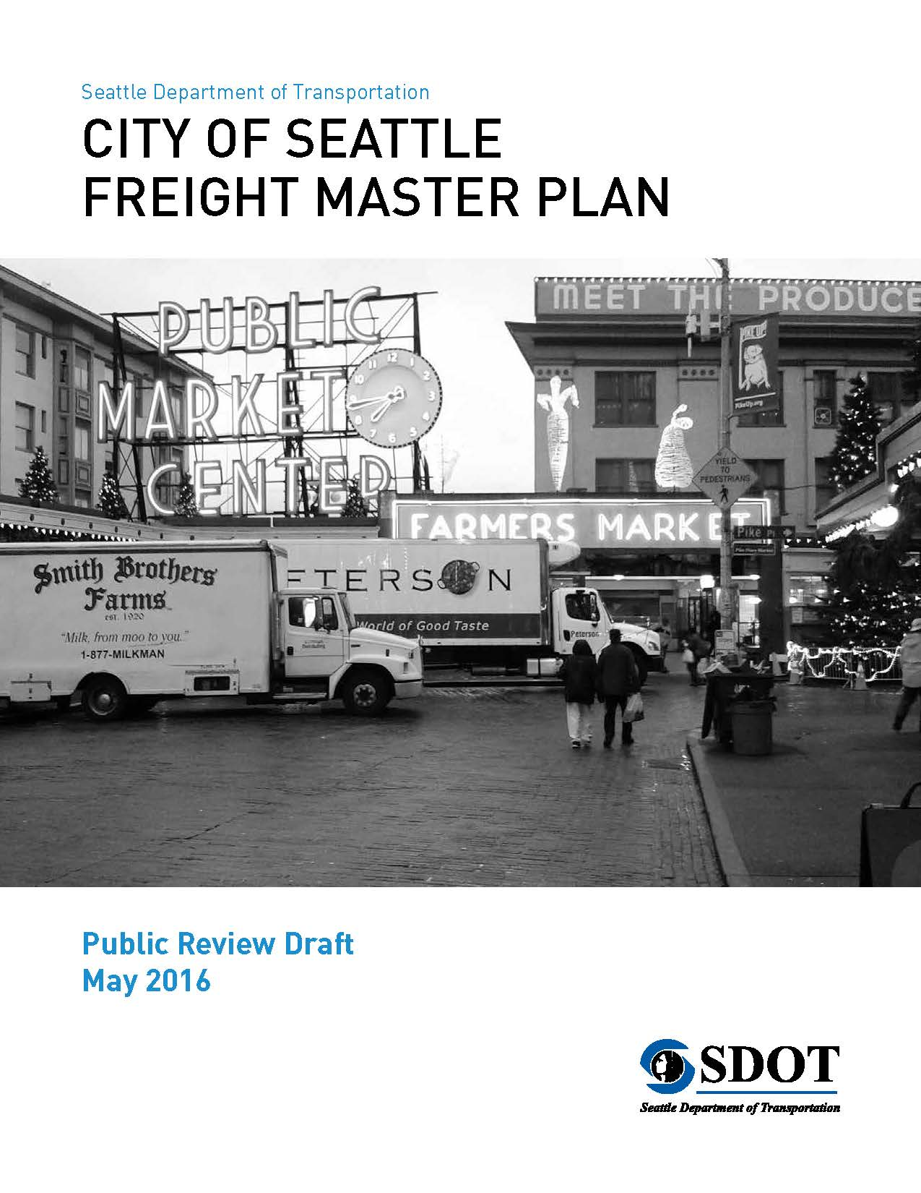
Citywide modal plan purposes
20-year blueprint to:
Support growth
Achieve desired outcomes
  Safety
  Affordability
  Connectivity
  Vibrancy
Increase travel options
Improve travel conditions
Guide investments

Slide 8
Citywide modal master plan contents
Seven “P”s
Policy framework
Priority investment network
Projects
Programs
Prioritization framework
Performance measures
“Pfunding” strategy
Other Elements
Best practices review
Existing conditions
Future conditions
Design guidelines
Project detail sheets
Implementation strategy
Outreach summary

Slide 9
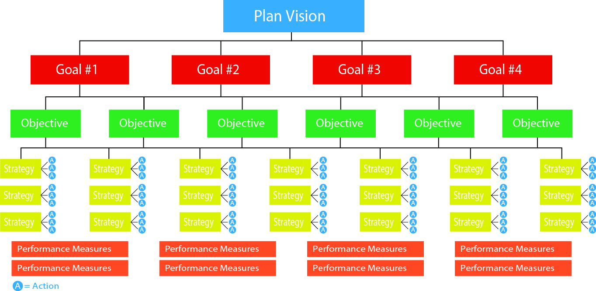
Policy framework
Notes:
Vision:
Articulates the desired future outcome of the Plan.
Goals:
Desired outcomes (what we hope to accomplish).
Objectives:
How we plan to accomplish the Plan goals.
Strategies:
Key actions for implementing each objective.
Performance Measures:
How we track progress in achieving Plan goals.

Slide 10
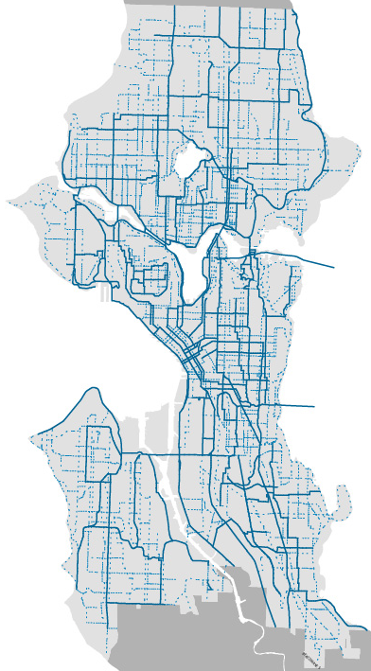
Bicycle Master Plan (2014)
Vision: Riding a bicycle is a comfortable and integral part of daily life in Seattle for people of all ages and abilities
Goals: Increase ridership and safety and enhance connectivity, equity and livability
Identifies an all ages and abilities network:
  Protected bike lanes
  Off-street trails
  Neighborhood greenways

Slide 11
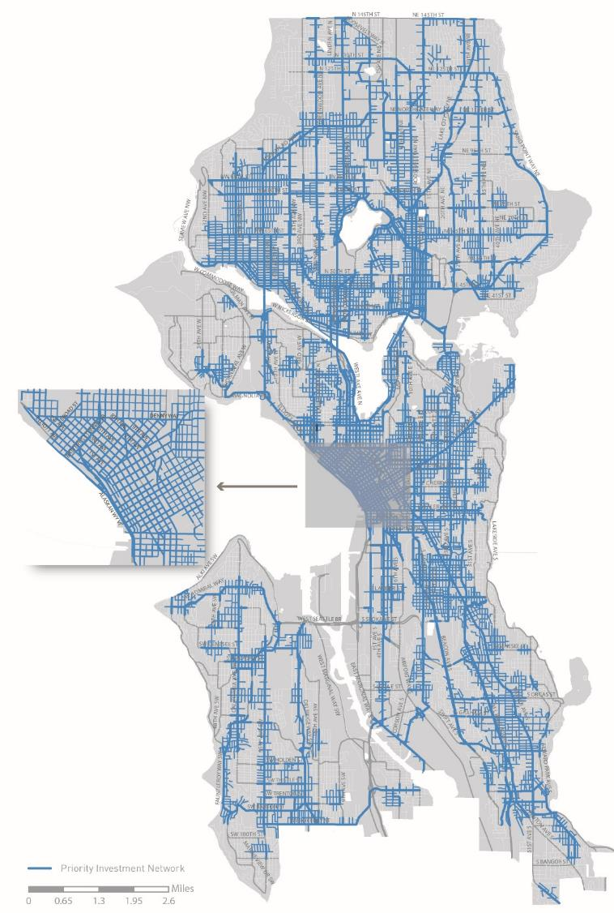
Pedestrian Master Plan Update (2016)
Vision: Seattle is the most walkable city in the Nation
Goals:
Safety: Reduce the number and severity of crashes involving pedestrians.
Equity: Make Seattle a more walkable city for all through equity in public engagement, service delivery, accessibility, and capital investments.
Vibrancy: Develop a connected pedestrian environment that sustains healthy communities and supports a vibrant economy.
Health: Get more people walking to improve mobility, health, and prevent disease.

Slide 12
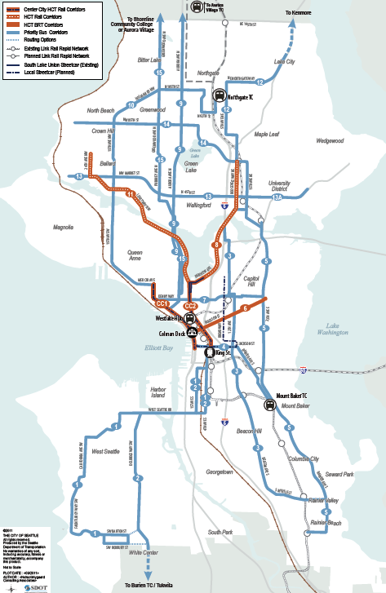
Transit Master Plan
(2012/2016)
Goal: Make riding transit easier and more desirable for more types of trips
2016 update focused on RapidRide BRT network expansion
Guides city purchase of Metro bus service

Slide 13
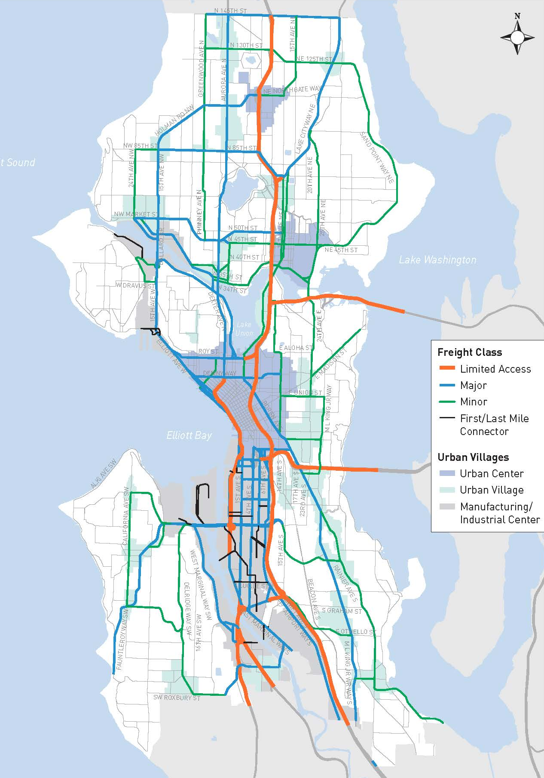
Freight Master Plan (2016)
Vision: A vibrant city and thriving economy connecting people, and products within Seattle, and to regional and international markets
Goals address:
  Economy
  Safety
  Mobility
  State of good repair
  Equity
  Environment

Slide 14
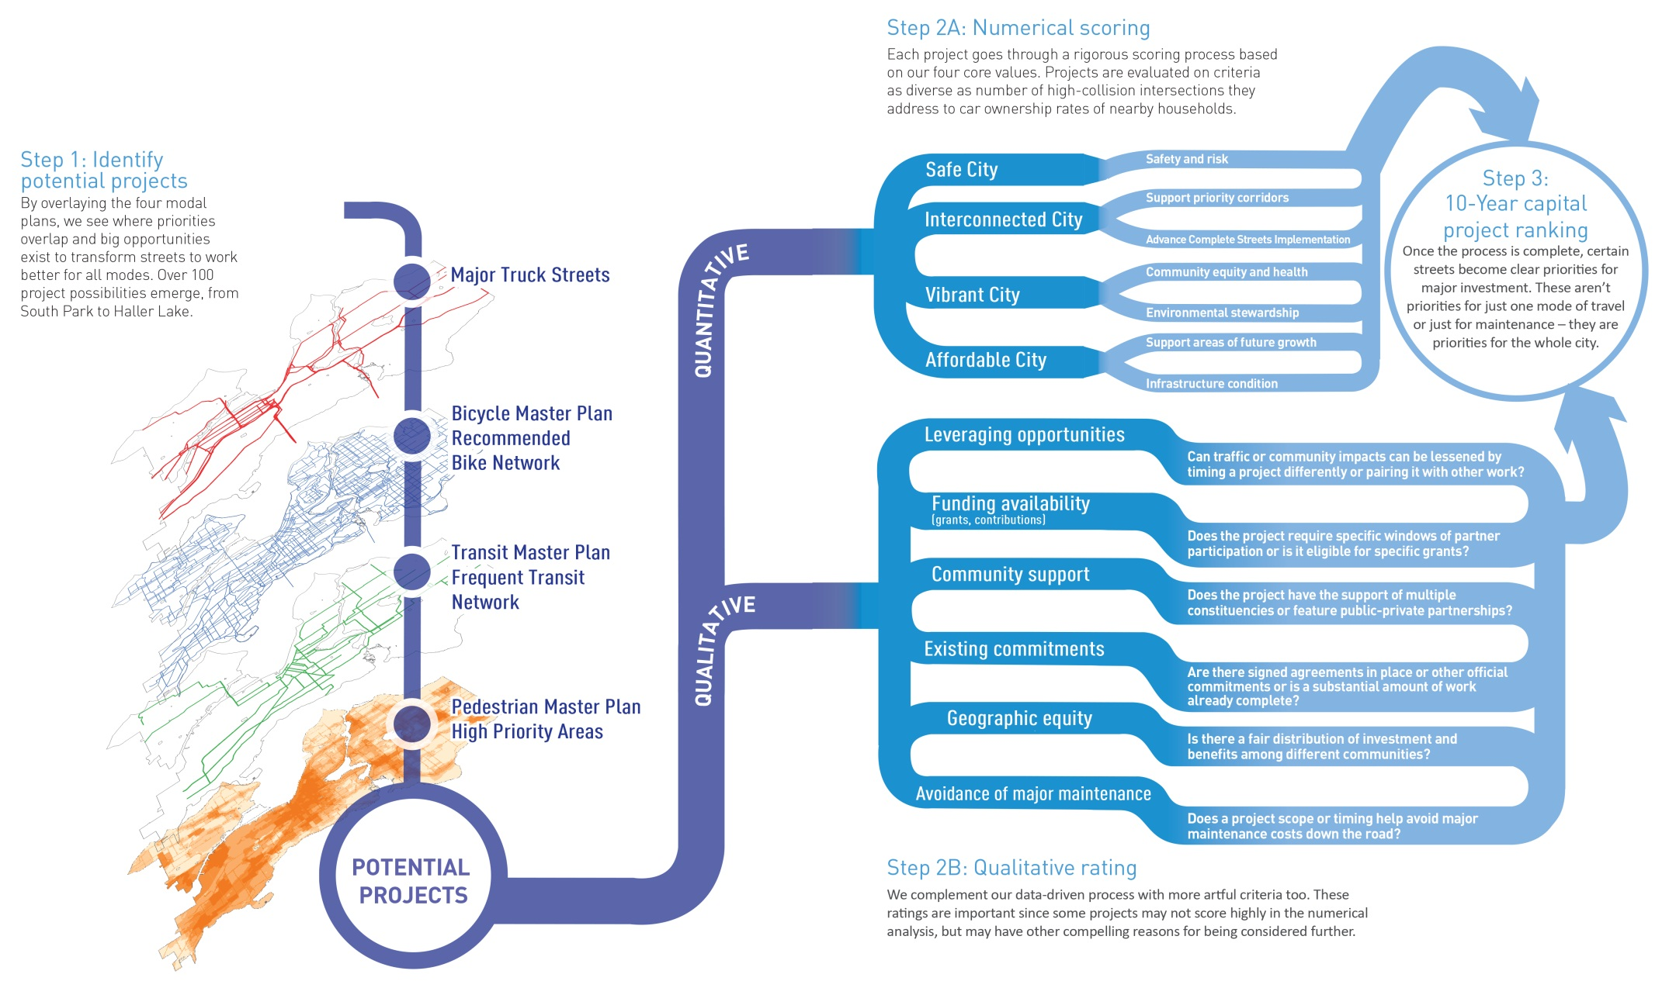
Prioritizing projects
14
Notes:
But how do we decide which projects to even begin work on? SDOT has a very rigorous, data-driven process that helps us identify the most pressing needs for limited funding in the city. It is summarized here:
Once we’ve overlaid the plans and our maintenance needs, we develop a long list of potential projects – this list is around 100 projects.
Those projects are then scored and ranked using quantitative data that supports our broader goals: data like numbers of collisions on the corridor, the state of the pavement, and even things like health indicators and car ownership rates in the surrounding neighborhood to ensure we’re investing equitably in all communities.
After this quantitative analysis, we also take into account more qualitative factors like: is funding available? If we do the project now, can we leverage major investment from other partners? And will completing the project now avoid major system maintenance costs later, equally a net benefit over time?
From there we narrow the list. The Move Seattle plan includes a 24 high-priority projects. When we look at a realistic forecast for funding over the next 10 years, we think about 17 of those can be completed in the Move Seattle timeframe. The are shown on the following map.

Slide 15
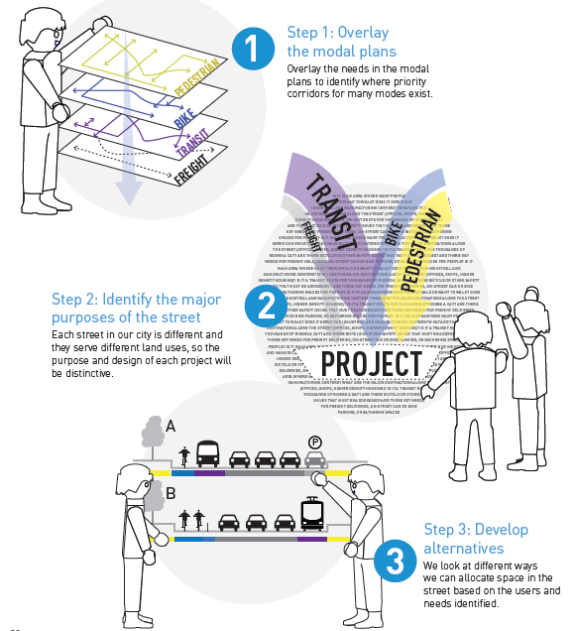
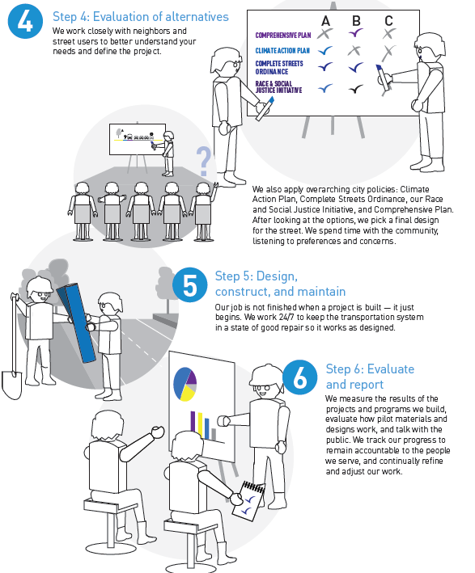
From plan to project
Notes:
First, we literally overlap the priorities in the plans in map analysis
Then, we take a look at the Comprehensive Plan, at land use, at the major functions of a street. For instance, 23rd Avenue in the Central District (a project underway now) is a critical transit corridor with pedestrian safety needs. East Marginal Way, south of downtown, is a crucial freight and bicycle route.
We then develop and evaluate alternatives – this is where we work closely with the community and users of a road.
Once an alternative is selected, it is designed and built.
And, this step is critical, our job just begins when a project is built – from there we evaluate and report on how it is functioning and begin the long task of maintaining it.

Slide 16
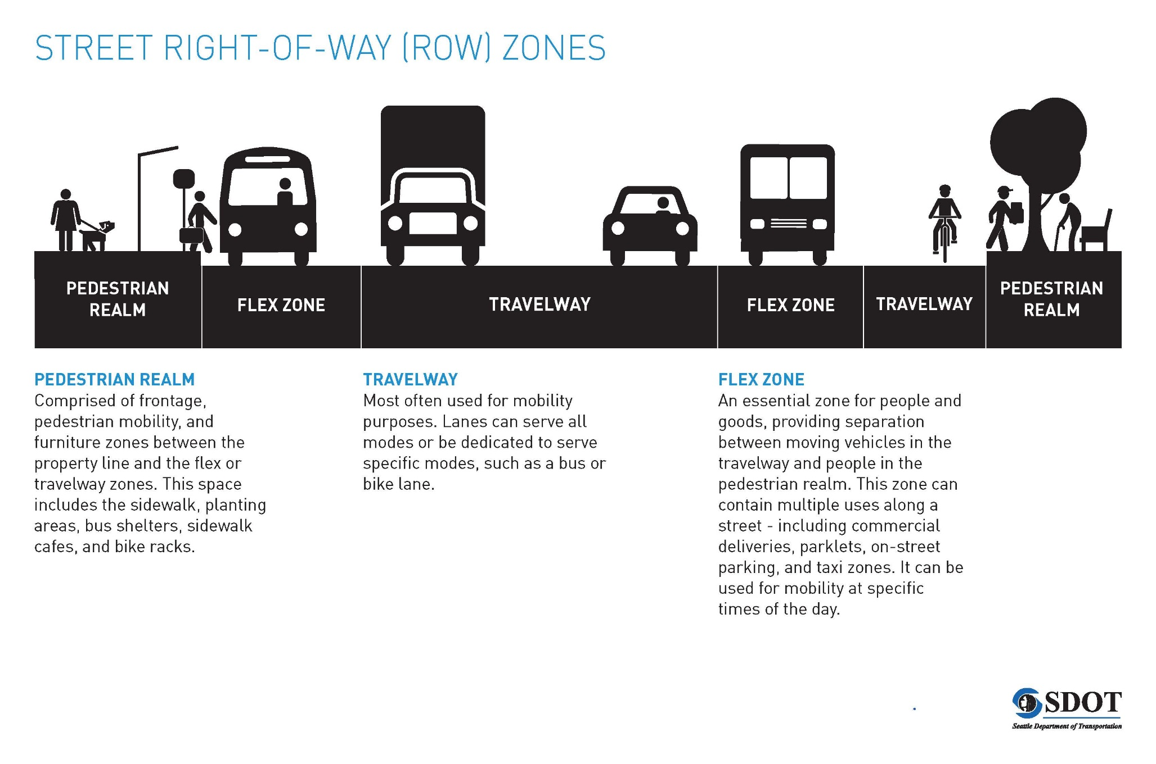
Street ROW Zones

Slide 17
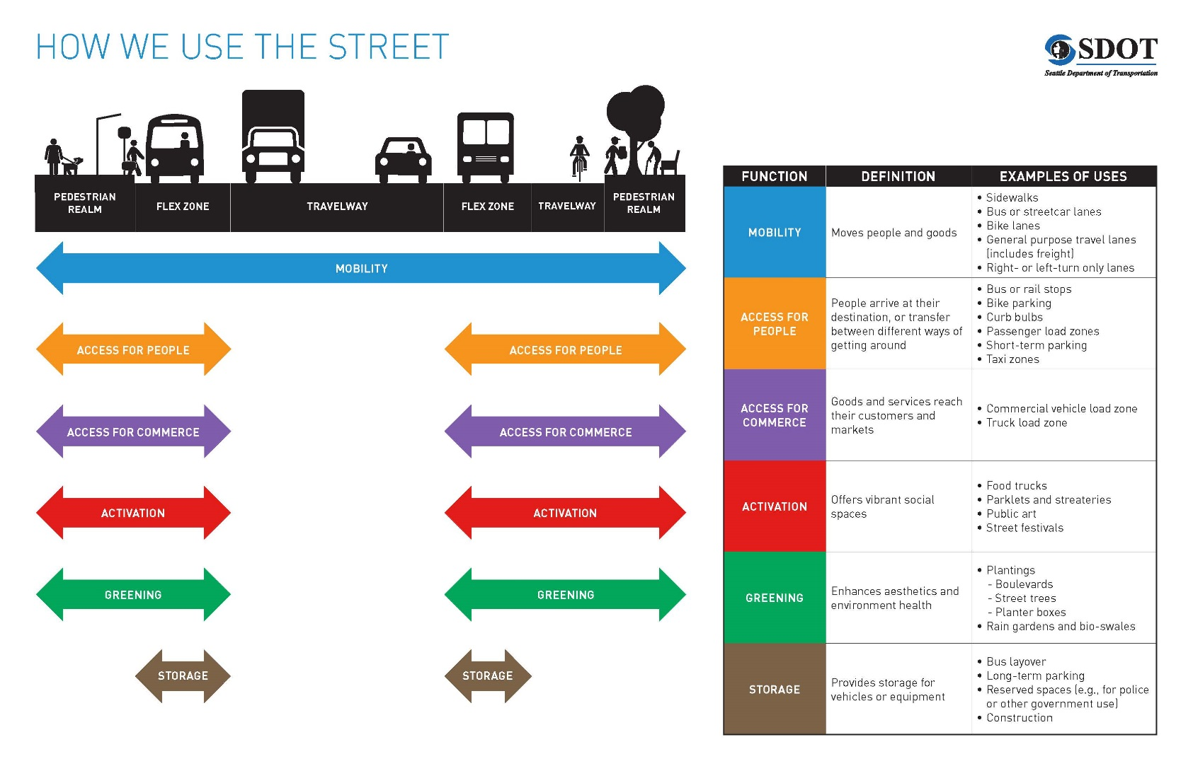
How we use the street

Slide 18
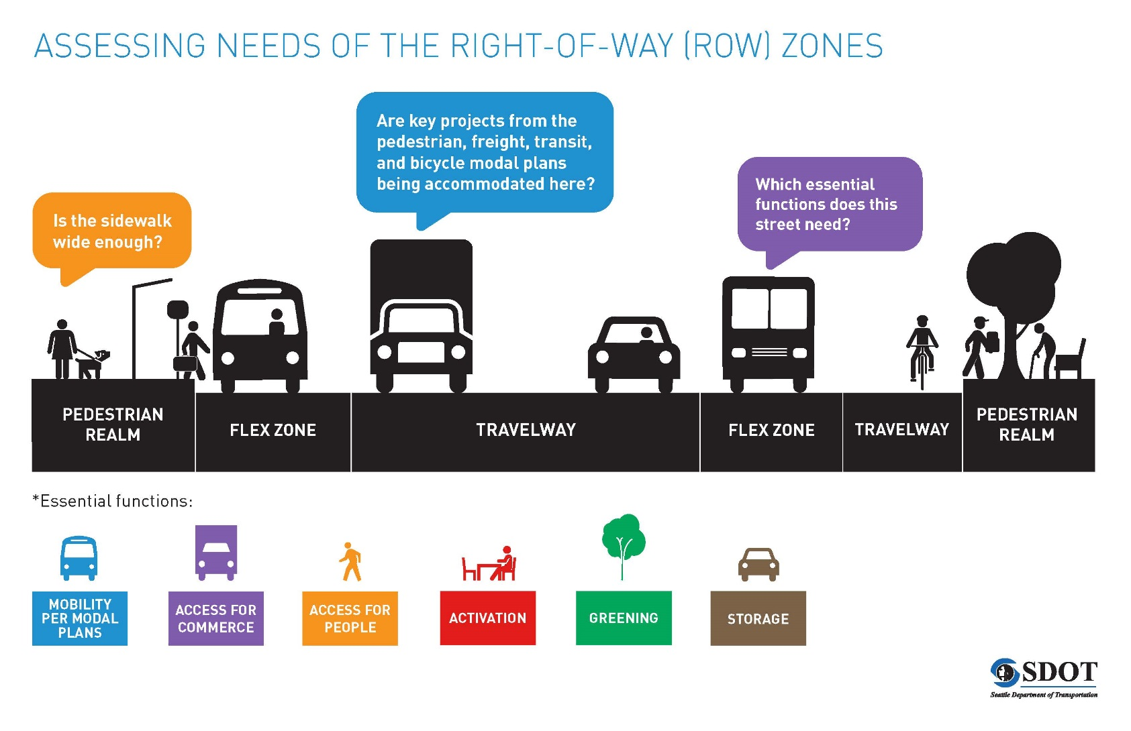
Assessing needs of the ROW zones

Slide 19





Questions?
tracy.krawczyk@seattle.gov | (206) 733-9329
http://www.seattle.gov/transportation/freight.htm
http://www.seattle.gov/transportation

